Slide 1

Future Tactical Management System
(fTMS)
Group 3
Jared Linklater, Jennifer Huynh, Christian Piscioneri

Slide 2
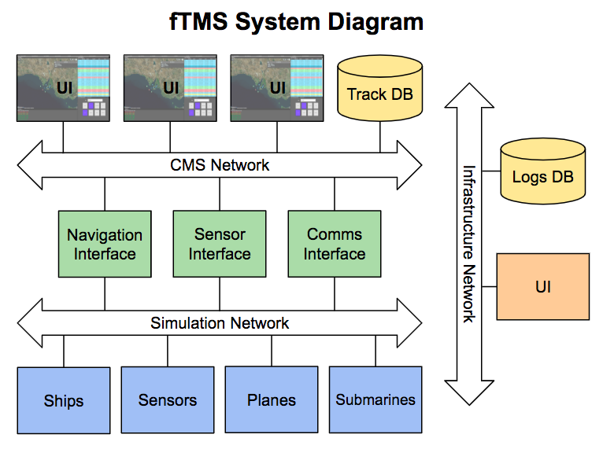
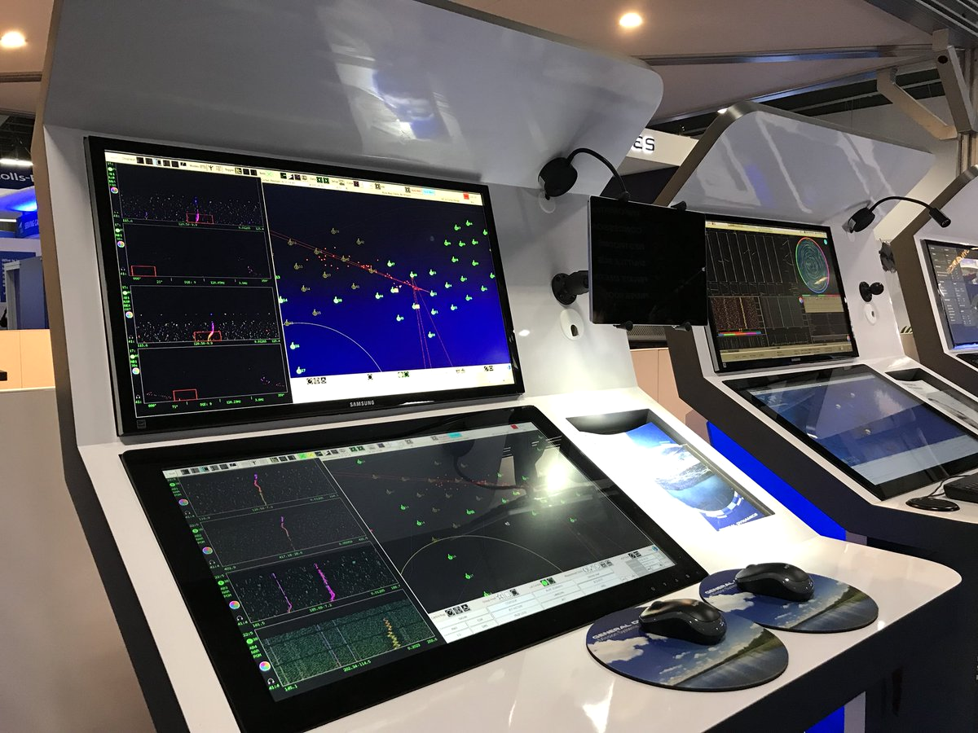
Introduction
A TMS is used on military vehicles to allow operators to see their surroundings and other close-by vehicles.
Main purpose is to provide visualisation and interaction.

Slide 3
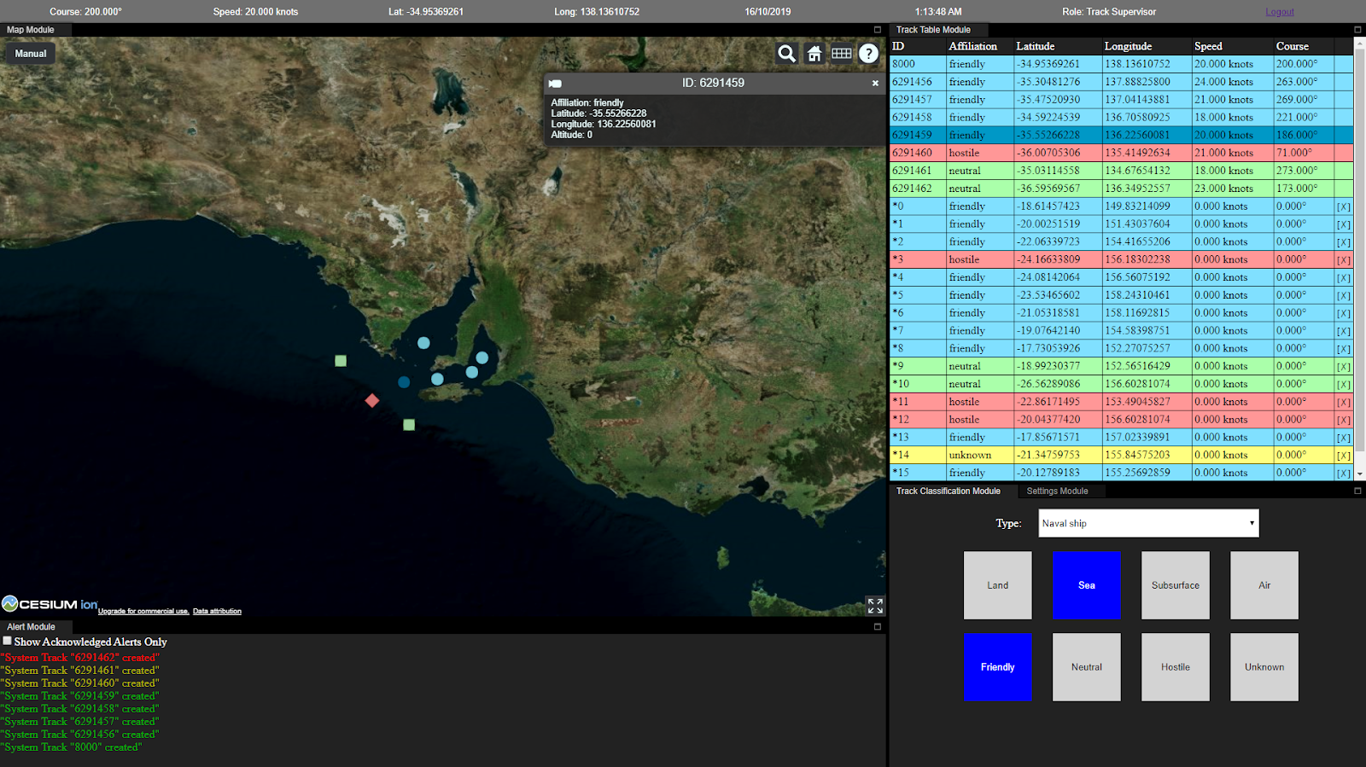

Slide 4
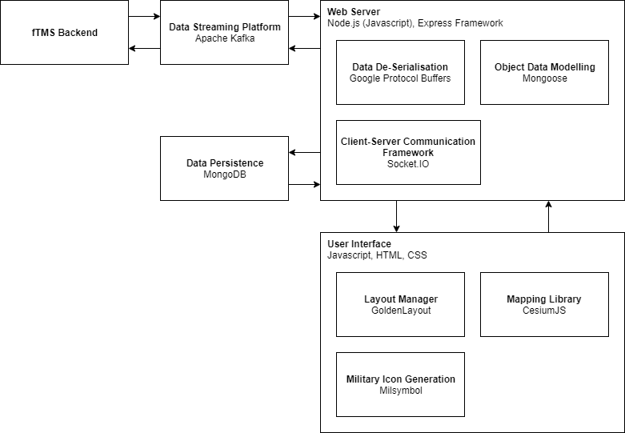






Technologies
Fast & flexible
Many plugins
Uses Javascript for both frontend and backend
Communication between clients and server
Streams data between our server and the TMS.
Notes:
https://drive.google.com/file/d/1-4qTF-LRUYu3DxbdsVgDQjWzVNTE2C2t/view?usp=sharing

Slide 5



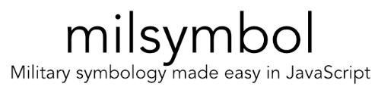
Technologies
Seamless window manager
responsive designs
To serialise structured data
Mainly used on track data
Notes:
https://drive.google.com/file/d/1-4qTF-LRUYu3DxbdsVgDQjWzVNTE2C2t/view?usp=sharing

Slide 6
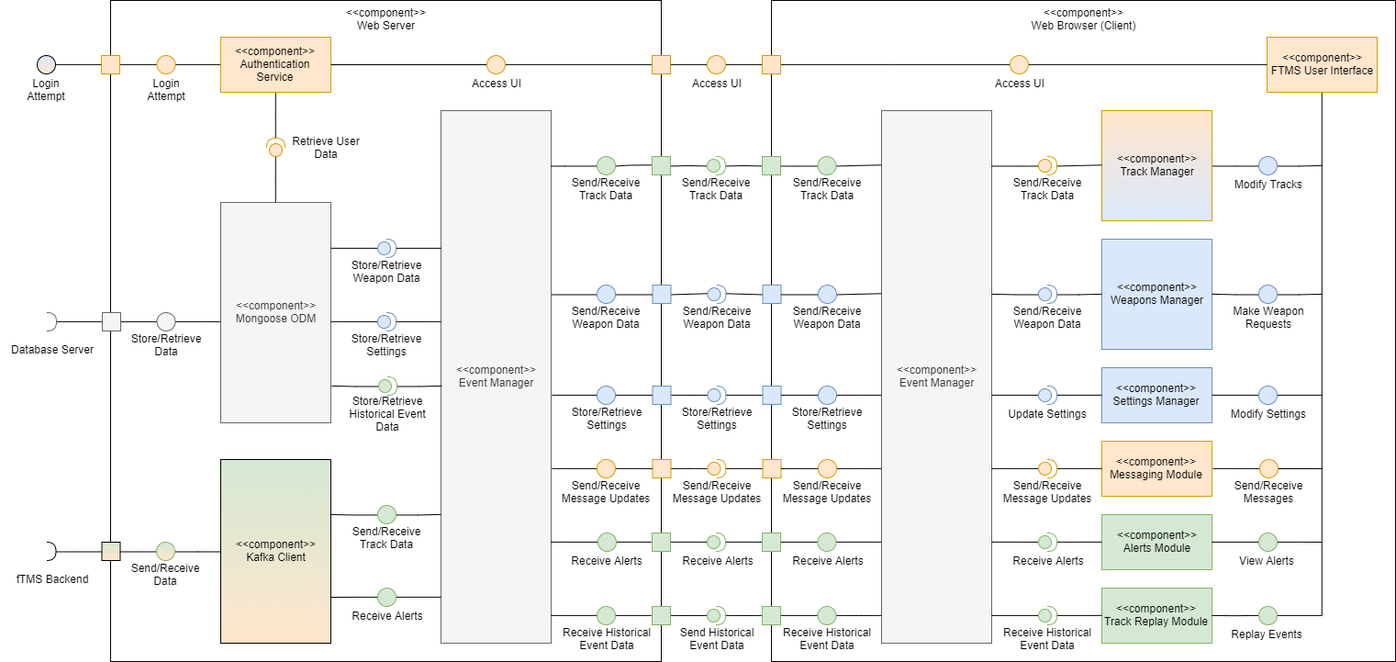
Architecture
 | Jared
 | Jennifer
 | Christian
 | All
Gradients indicate mixed contributions
UML Component Diagram of fTMS Frontend (Logical View)

Slide 7
Data Visualisation: Map Component
Client component was required to...
Display all tracks on a map, with icons following MIL-STD-2525D military standards
Allow tracks to be manually placed on the map
Lock the map to the track that represents the vehicle the system is running on (a.k.a ‘ownship’)
Show map tiles even when disconnected from public internet
Solution: CesiumJS, Milsymbol
Cesium had many features we required (interactivity, camera locking, offline maps)
Handles large number of tracks well
Milsymbol allows for fast, simple and correct generation of military icons

Slide 8
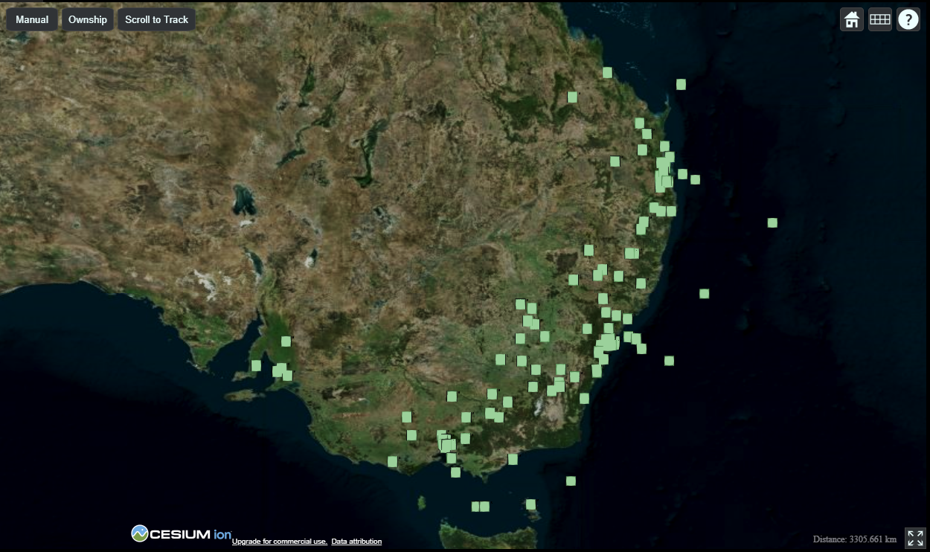

Slide 9
Meeting Performance Requirements
Client component was required to...
Display 20 tracks at once with insignificant performance trade-off
Display track updates within 1 second of data reaching server
Display new track within 1 second of data reaching server
Solution: Socket.IO, Track Manager, Observer Pattern
Socket.IO allows for fast communication between server and connected clients
Track Manager handles creating and storing tracks on the client-side
Observer pattern allows visual components to listen for new tracks & updates to existing tracks
Helps achieve loose coupling & reduces time complexity of functions

Slide 10
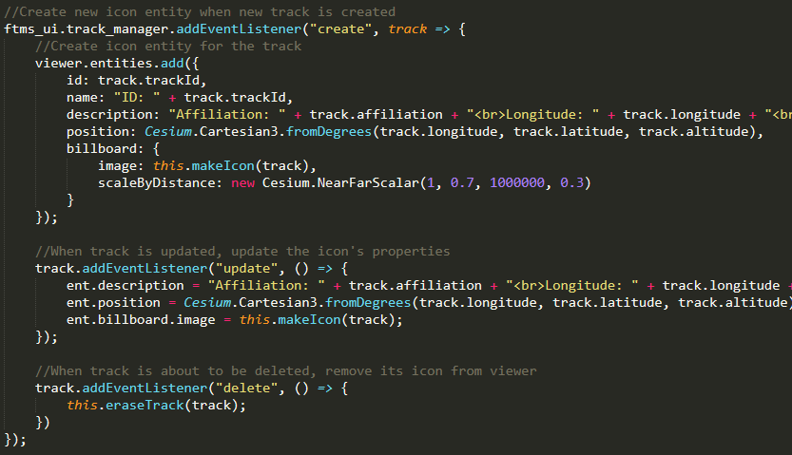
Observer Pattern Example
When track is created: create an icon & attach other listeners.
When track is updated: update track’s icon.
When track is deleted: delete track’s icon.

Slide 11
Persistence: MongoDB & Mongoose ODM
Server component was required to...
Store user data, system settings & layouts
Verify that data to be stored by the system was valid
Solution: MongoDB & Mongoose ODM
MongoDB is fast and flexible with a useful GUI (MongoDB Compass)
Stores JSON-like objects; perfect fit for Javascript
Mongoose ODM helps verify schemas and simplify code

Slide 12
Role-Based Access Control & Sessions
Server component was required to...
Provide authentication and authorisation for users; serve the correct views to a given user
Securely store user credentials
Securely manage user web sessions
Solution: Express Framework & Bcrypt Hashing
Mongoose helps verify login attempts against stored, valid credentials
Express has a session module that makes session managing simple
Bcrypt provides industry-standard password hashing & salting

Slide 13
Track Classification Component
This component needed to...
Allow for changes to be made to the properties of a track
Update any changes that are made to a track’s properties
Reflect these changes for all connected clients

Slide 14
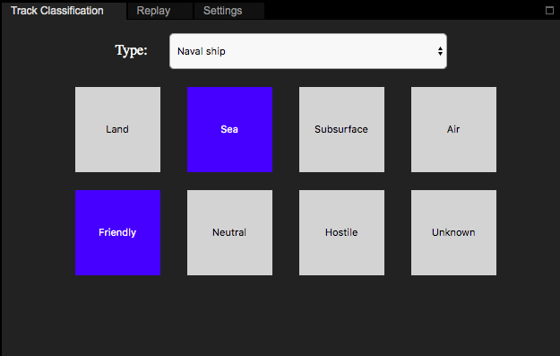
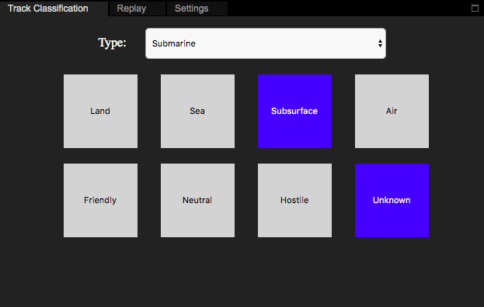
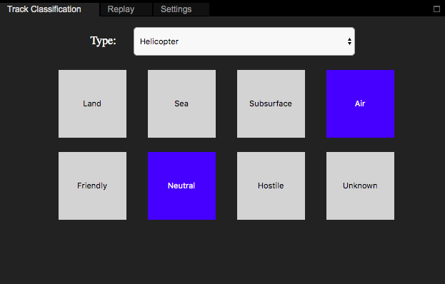
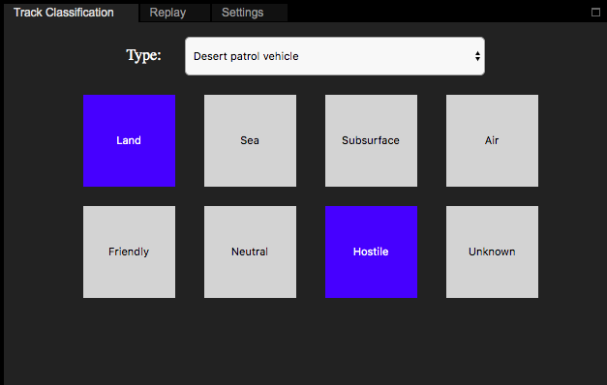
Track Classification Component
Solution:
Large intuitive buttons that reflect the different properties
Update events are sent to the server and passed to connected clients
Observer pattern allows for other modules to update track appearance

Slide 15
Weapon Communication Components
These components needed to...
Allow for authorised operators to send off firing requests
Ensure asynchronous requests are received and approval/denial can be given
Allow for the firing of an approved weapon against selected track

Slide 16
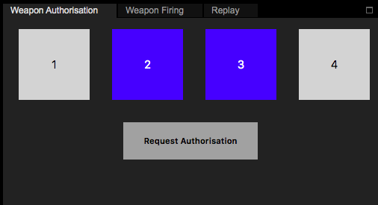
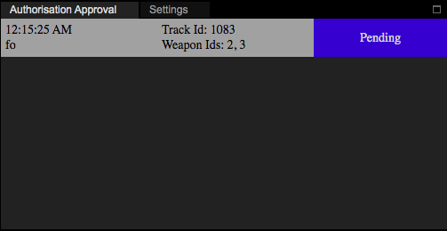
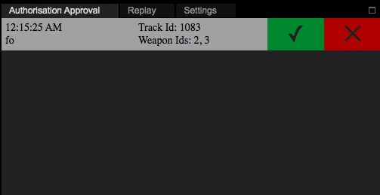
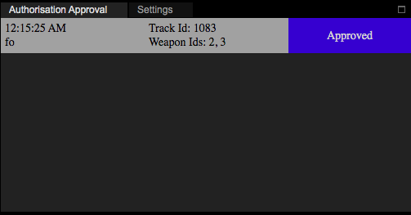
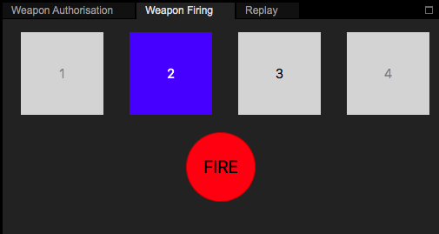
Weapon Communication Components
Solution:
Firing request is sent to the server and stored in the database
Server passes the request to other connected clients
When a response is given, database updates the status and sends back to clients

Slide 17
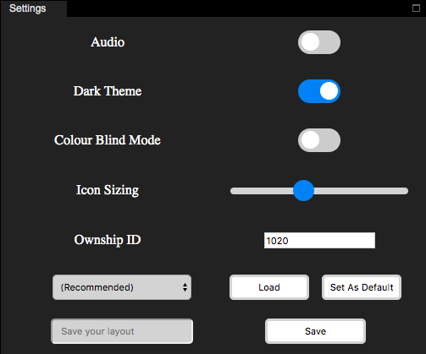
Settings Component
This component was required to...
Provide user customisation
Save and load user settings
Store and load user layouts
Solution: Settings Manager
Settings manager stores settings on the client side
It retrieves settings from the server and lets the system know when it’s ready to load

Slide 18
Kafka Streams
Data Streams
Plug ‘n’ Play
Track Data
Alerts
Protocol Buffer
Track Updates

Slide 19
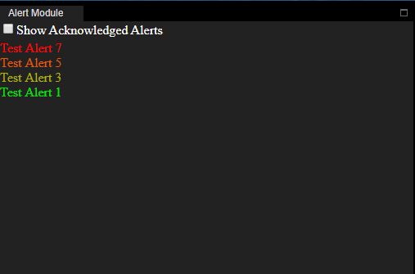
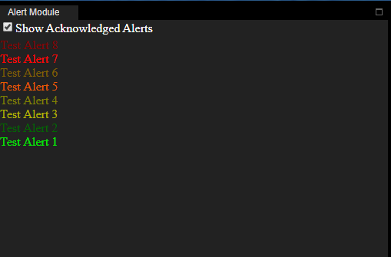
Alerts Component
Important Events
Colour Coding
Hide Acknowledged Alerts

Slide 20
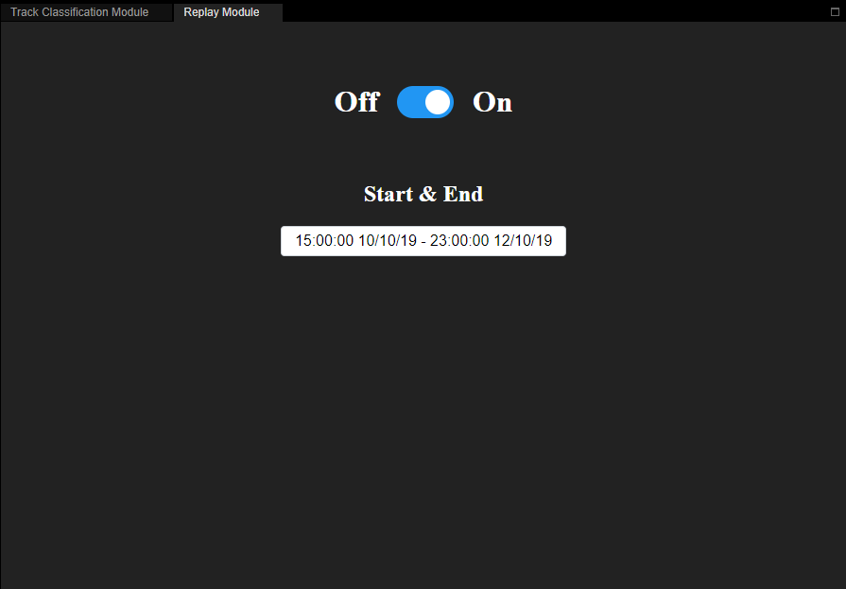
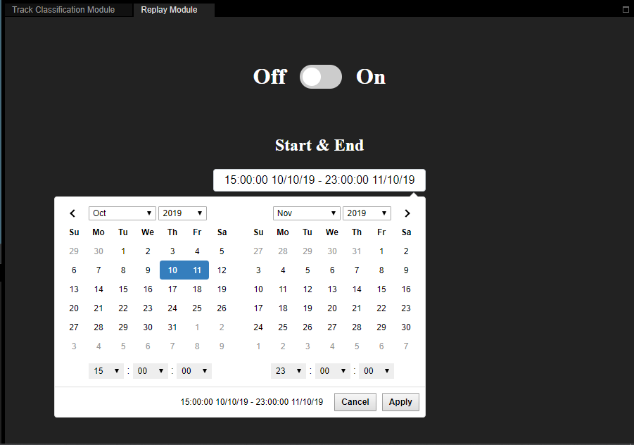
Track Replay Component
View Past Events
Playback as they happened

